Slide 1
New Tork Hygiene Stand
2017

Slide 2
Workplace hygiene becomes more and more important
An open office plan means sitting closer to colleagues or even sharing desks. More sharing means more people worry about office hygiene.*
The solution? Make hygiene products available in the office environment.
Put hygiene at
the heart of your business
*2013 SCA/BuzzBack study in UK, USA, France and Germany

Slide 3
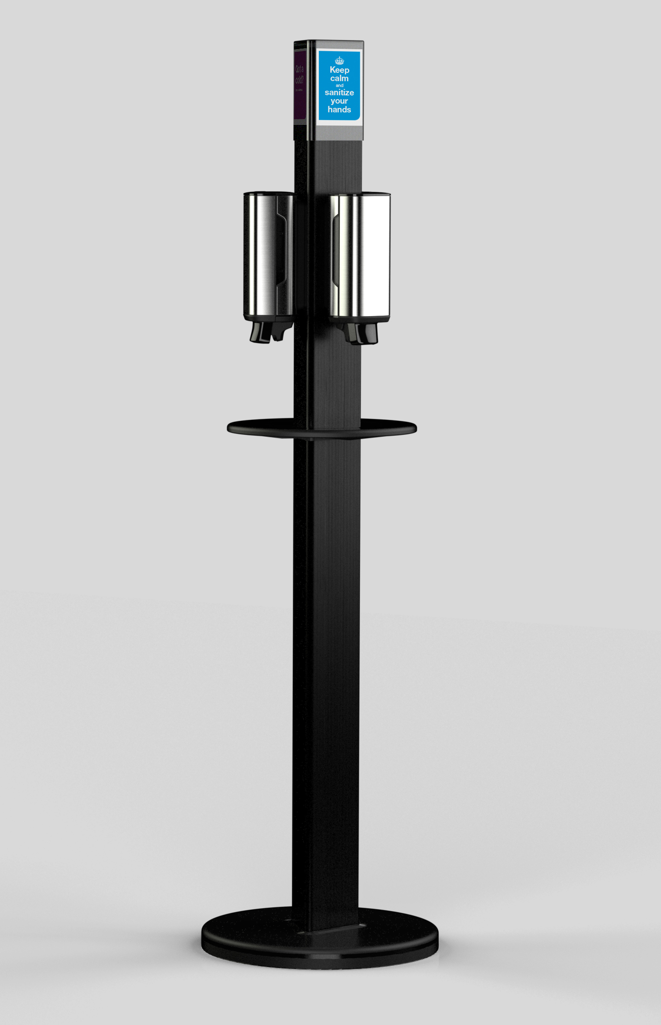
Tork Hygiene Stand
– perfect for open offices or other public
Provides the hygiene solutions you need at the heart of your office environment
Show your employees that you care about their well-being
Remind your employees and visitors of hand hygiene
A sleek design blending in perfectly in the modern office landscape
Works with both Tork Image Design™ and Elevation Line dispensers
Stable enough for both manual and sensor dispensers

